Slide 1
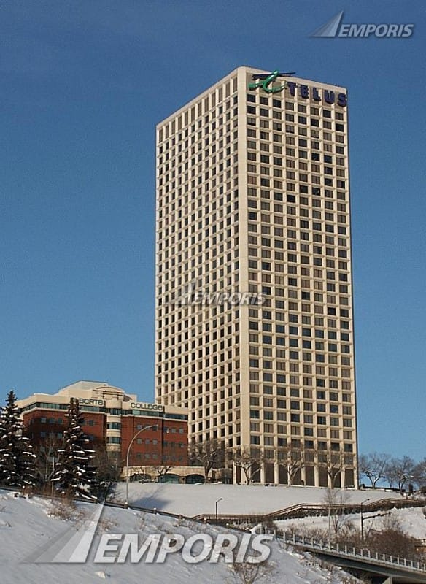
Green Building
Def: Green building is the structure and the application of process that are environment friendly and resource efficient during the entire building process.
Example of good green building
Telus house atrium

Slide 2
Architectural Design
Def: is the strategy of building with the aim of reducing harmful impact on the environment and this should be the aspect of every building process.
For instance the K2 ARPARTMENT that is the most sustainable public housing strategy in Australia.
Its estimated lifespan is not less than 200 years
Consumes renewable sources of energy.

Slide 3
Features of Architectural Design
Rainwater harvesting
Recycled timber
Sun water heating
Photovoltaic panels

Slide 4
EXT.
Center for sustainable development architecture design was situated in Montreal Canada.
Function was to act as a model for environmentally friend construction.
Most people refer to it as greenest construction in Canada.

Slide 5
Design Features
Five-storeyed wall acting as natural air filter
Raising floor heating
Geothermal cooling and heating machines.
Recycled glasses which makes the countertops

